Slide 1
CALCULUS
Notes:
General introduction to calculus, tools and applications.

Slide 2
Chapter 1: Function and limit
Objectives
Four ways to represent a function
Basis functions and the transformations of functions
Calculating limits of functions
(limits at a point, limits involving Infinity)
Verifying continuity of a function
Notes:
the importance of basic elementary functions, limits and continuity

Slide 3
FUNCTIONS AND LIMITS
1.1
Functions and
Their Representations
Notes:
Understanding the interplay between the four ways of representing a function (verbally, numerically,…)
Find the domain and range
Determine even and odd function
Working with piecewise defined function

Slide 4
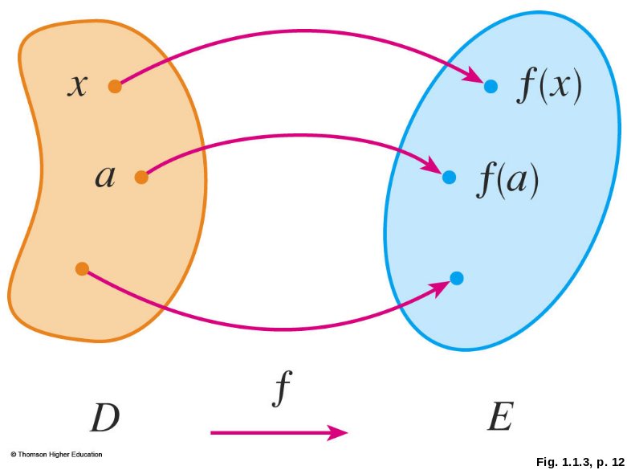
FUNCTION
A function f is a rule that assigns to each element x in a set D exactly one element, called f(x), in a set E.
The set D is called the domain of the function f.
The range of f is the set
of all possible values
of f(x) as x varies
throughout the domain.
Notes:
exactly one ; D, E in R; domain and range

Slide 5

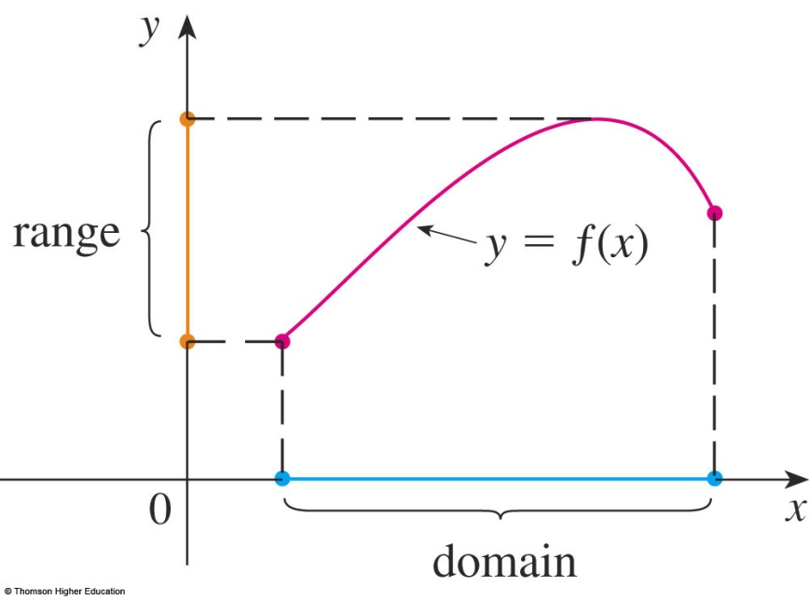
GRAPH
The graph of f is the set of all points (x, y) in the coordinate plane such that y = f(x) and x is in the domain of f.
The graph of f also allows us to picture:
  The domain of f on the x-axis
  Its range on the y-axis
Notes:
Perpendicular projection of the graph to the Ox is domain
Perpendicular projection of the graph to the Oy is range

Slide 6
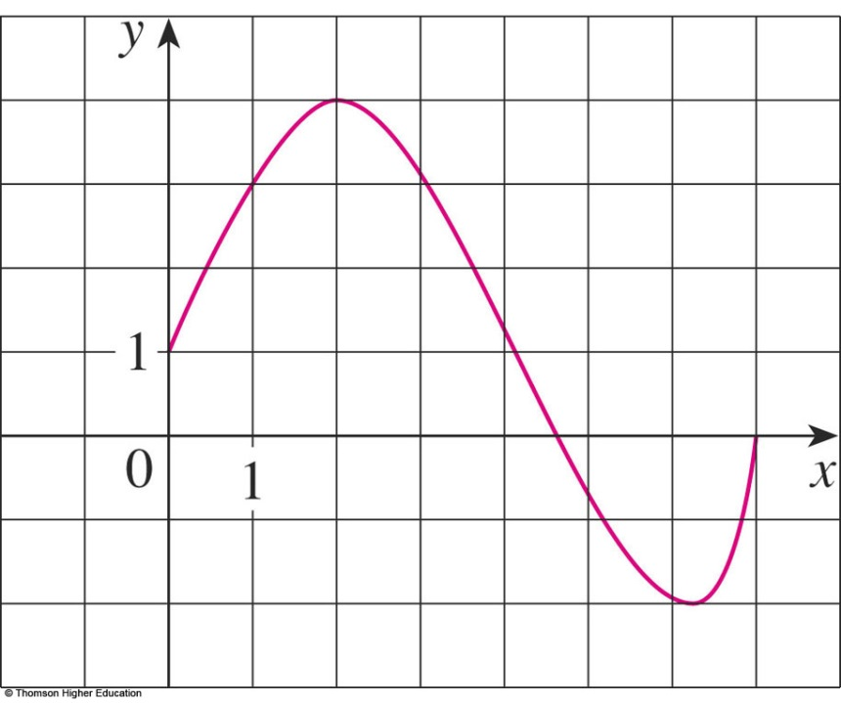
GRAPH
Example 1
The graph of a function f is shown.
Find the values of f(1) and f(5).
What is the domain and range of f ?
f(1) = 3
f(5) ≈ - 0.7
D = [0, 7]
Im(f) = [-2, 4]

Slide 7
REPRESENTATIONS
DISCUSSION
Find the domain and region of the functions ( if it is a function).
a.
b.
Notes:
Any real number

Slide 8
REPRESENTATIONS OF FUNCTIONS
There are four possible ways to represent a function:
  Algebraically (by an explicit formula)
  Visually (by a graph)
  Numerically (by a table of values)
Notes:
depending on situations where there is a suitable description

Slide 9
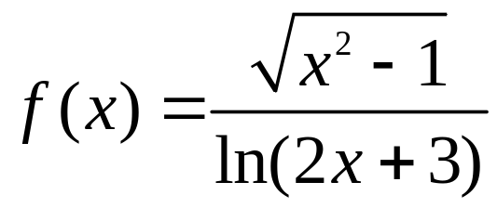
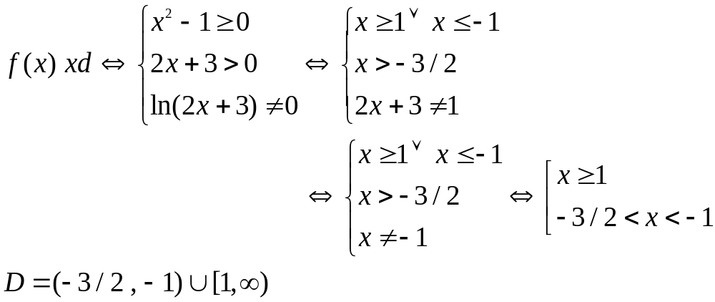

Slide 10
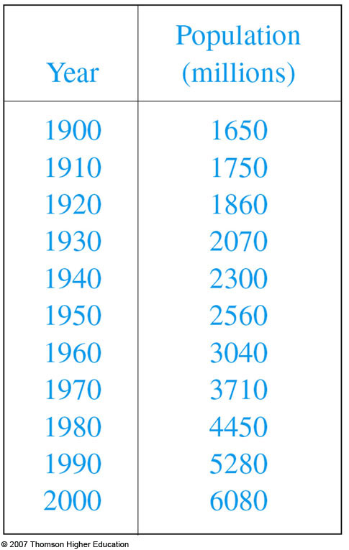
EXAMPLE B
The human population of the world P depends on the time t.
  The table gives estimates of the
  world population P(t) at time t,
  for certain years.
  However, for each value of the
  time t, there is a corresponding
  value of P, and we say that
  P is a function of t.

Slide 11
THE VERTICAL LINE TEST
A curve in the xy-plane is the graph of a function of
x if and only if no vertical line intersects the curve
more than once.
Notes:
This test does not indicate the equation of the curve

Slide 12
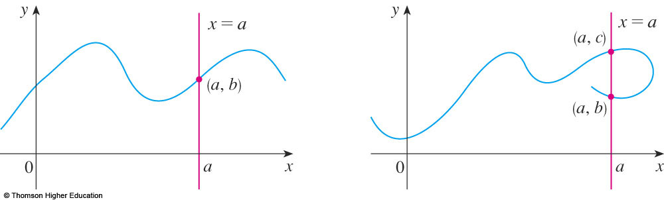
THE VERTICAL LINE TEST
The reason for the truth of the Vertical Line Test can be seen in the figure.

Slide 13
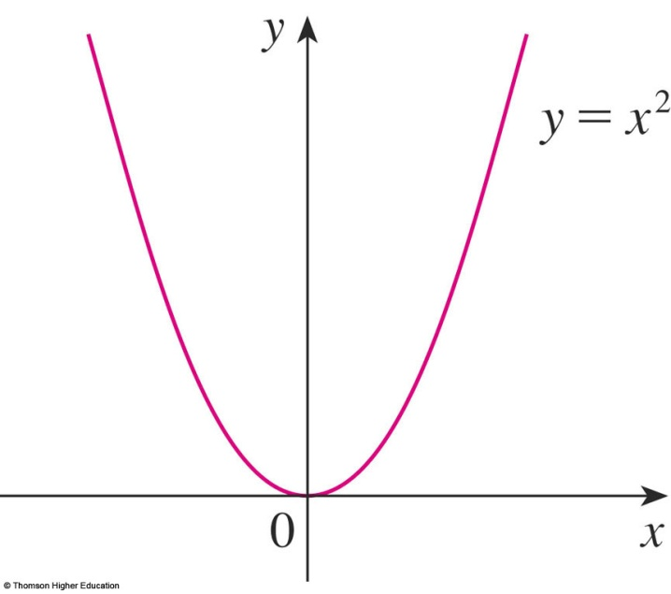
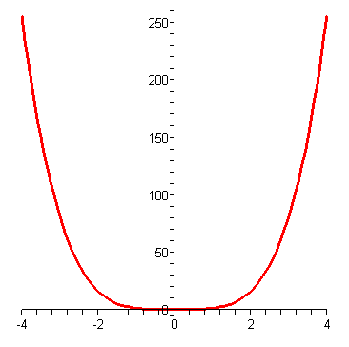
SYMMETRY: EVEN FUNCTION
movie
If a function f satisfies:
f(-x) = f(x), ∀ x ∈ D
then f is called an even function.
  The geometric significance of an even function is that its graph is symmetric with respect to the y-axis.
y = x⁴
Notes:
-x also in D

Slide 14
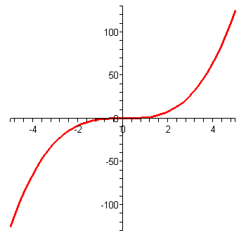
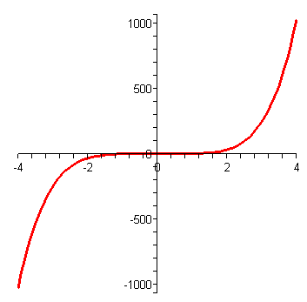
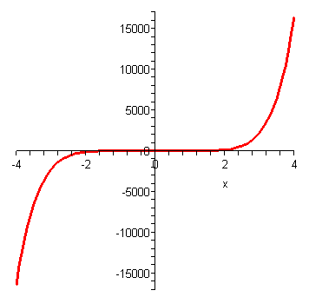
SYMMETRY: ODD FUNCTION
movie
If f satisfies:
f(-x) = - f(x), ∀x ∈ D
then f is called an odd function.
  The graph of an odd function is symmetric about the origin.
y = x³
y = x⁵
y = x⁷
Notes:
-x also in D

Slide 15
Example
Let f is an odd function. If (-3,5) is in the graph of f then
which point is also in the graph of f?
a. (3,5) b. (-3,-5) c. (3,-5) d. All of the others
Answer: c

Slide 16
Example 11
Suppose f is an odd function and g is an even function.
What can we say about the function f.g defined by (f.g)(x)=f(x)g(x)?
Prove your result.
Notes:
Check (f.g) (-x) = ? (f.g)(x)

Slide 17
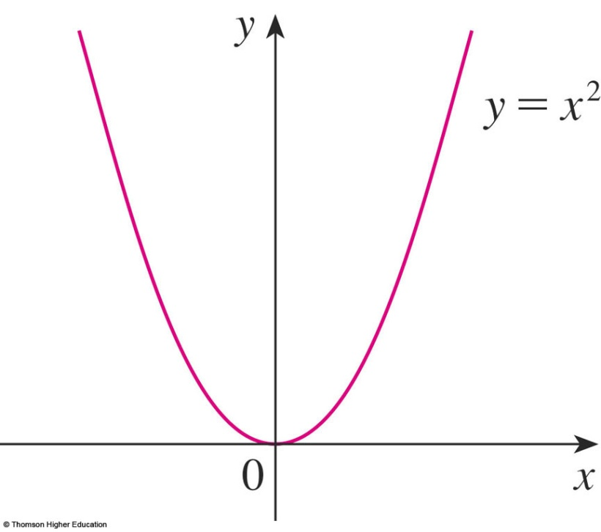
INCREASING AND DECREASING FUNCTIONS
A function f is called increasing on an interval I if:
f(x₁) < f(x₂) whenever x₁ < x₂ in I
It is called decreasing on I if:
f(x₁) > f(x₂) whenever x₁ < x₂ in I
Notes:
Monotonic

Slide 18
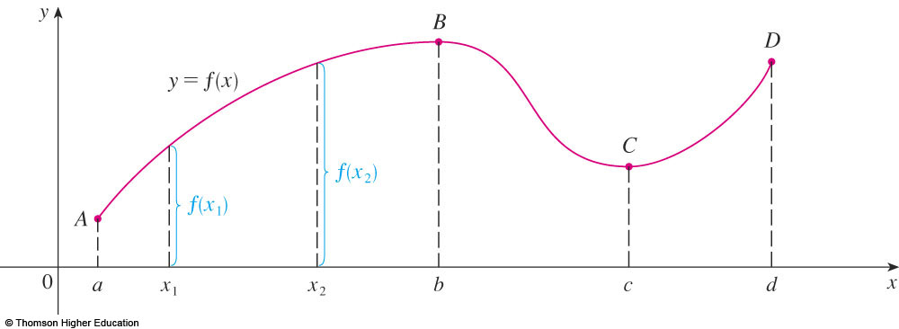
INCREASING AND DECREASING FUNCTIONS
The function f is said to be increasing on the interval [a, b], decreasing on [b, c], and increasing again on [c, d].

Slide 19
1.1 QUIZ QUESTIONS
If f is a function then f(x+2)=f(x)+f(2)
True b. False
2) If f(s)=f(t) then s= t
True b. False
3) Let f be a function.
We can find s and t such that s=t and f(s) is not equal to f(t)
a. True b. False

Slide 20
FUNCTIONS AND MODELS
1.2
MATHEMATICAL MODELS:
A CATALOG OF
ESSENTIAL FUNCTIONS
In this section, we will learn about:
The purpose of mathematical models.
Notes:
MODEL = FUNCTION

Slide 21

MATHEMATICAL MODELS
A mathematical model is a mathematical description—often by means of a function or an equation—of a real-world phenomenon such as:
  Size of a population
  Demand for a product
  Speed of a falling object
  Life expectancy of a person at birth
  Cost of emission reductions
Notes:
The modeling process: developing, analyzing and interpreting a mathematical model.
Classes of functions: linear, power, rational, algebraic, trigonometric, exponential and transcendental functions.

Slide 22
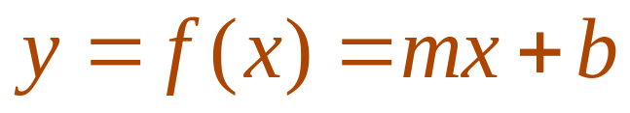
LINEAR MODELS
When we say that y is a linear function of x, we mean that the graph of the function is a line.
  So, we can use the slope-intercept form of the equation of a line to write a formula for the function as
  where m is the slope of the line and b is the y-intercept.
Notes:
the graph of the function is a line; meaning of slope and y - intercept

Slide 23
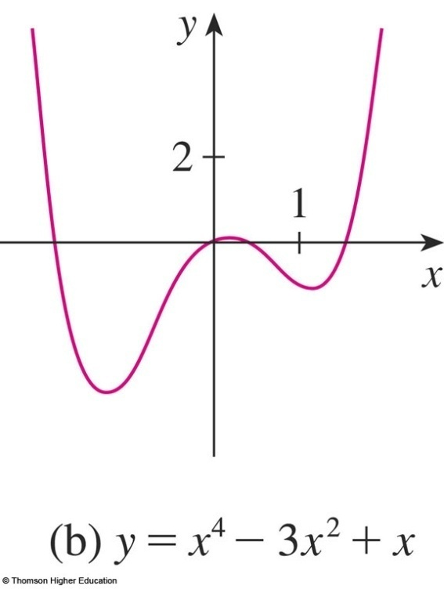
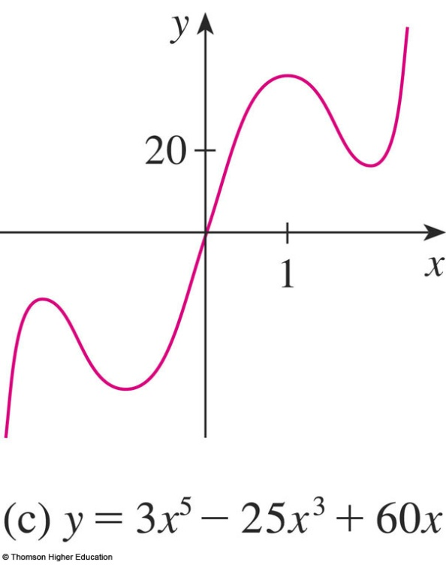
POLYNOMIALS
A function P is called a polynomial if
P(x) = a_{n}x^{n} + a_{n-1}x^{n-1} + … + a₂x² + a₁x + a₀
where n is a nonnegative integer and the numbers
a₀, a₁, a₂, …, a_{n} are constants called the coefficients of the polynomial.
Notes:
a_{n} ≠0

Slide 24
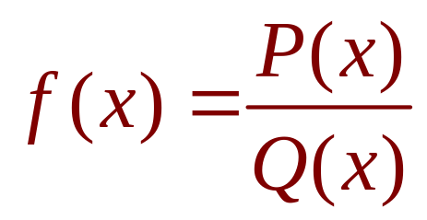
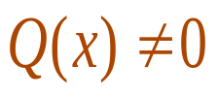
RATIONAL FUNCTIONS
A rational function f is a ratio of two polynomials
where P and Q are polynomials.
  The domain consists of all values of x
  such that .
Notes:
P and Q are polynomials

Slide 25
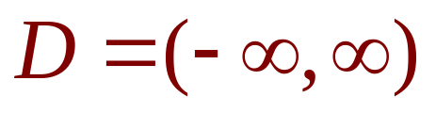
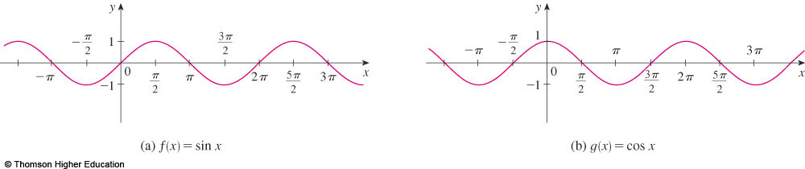
TRIGONOMETRIC FUNCTIONS
f(x) = sin x
f(x) = cos x
R = [-1, 1]
Notes:
Sin(-x)=sinx
Cos(-x) = cosx
R = [-1, 1]

Slide 26
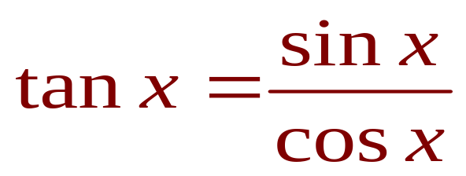
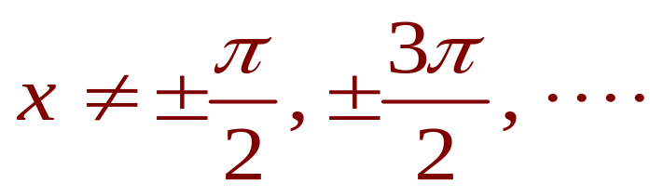
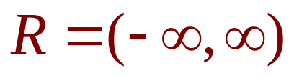

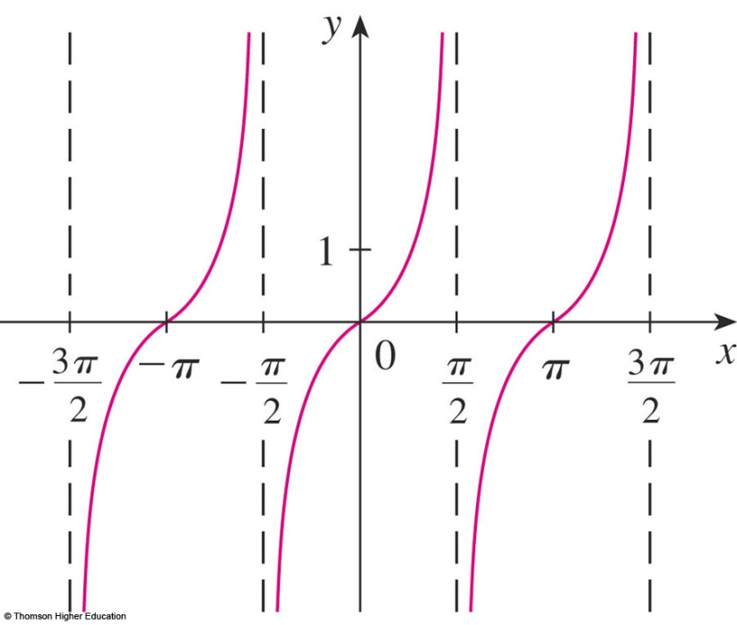
TRIGONOMETRIC FUNCTIONS
Notes:
Range = (-∞,∞)

Slide 27
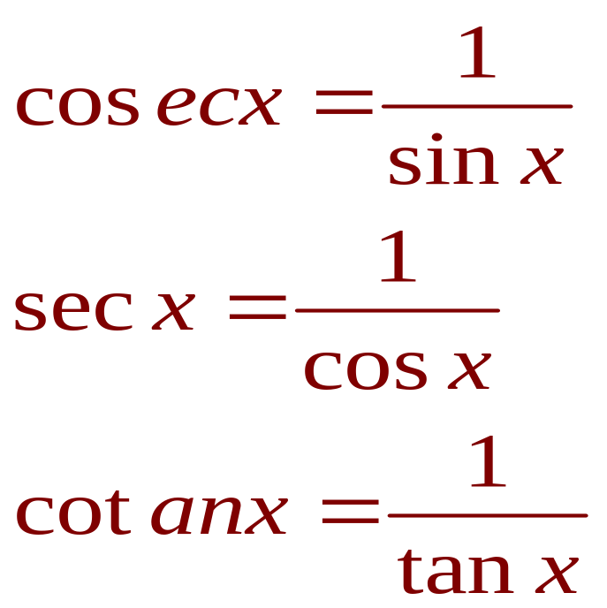
TRIGONOMETRIC FUNCTIONS
The reciprocals of the sine, cosine, and tangent functions are

Slide 28
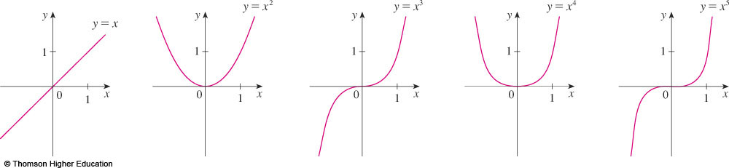
POWER FUNCTIONS
A function of the form f(x) = x ª , where a is constant, is called a power function.
Notes:
Domain?
Range?

Slide 29
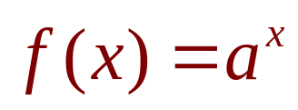


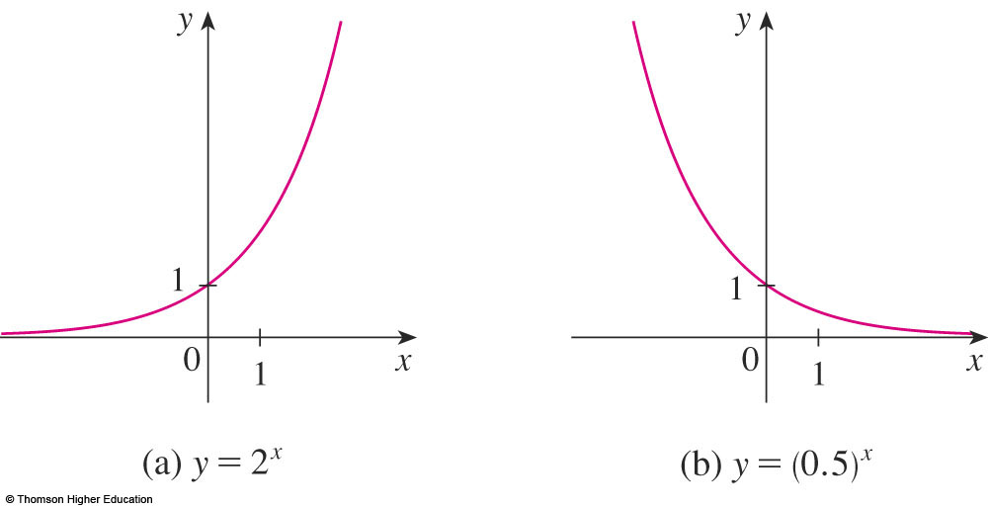
EXPONENTIAL FUNCTIONS
The exponential functions are the functions of the
form , where the base a is a positive constant.
  The graphs of y = 2^{x} and y = (0.5)^{x} are shown.
  In both cases, the domain is and the range
  is .
Notes:
Domain?
Range?
Graph when a>1; a<1

Slide 30
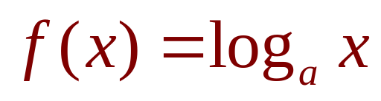
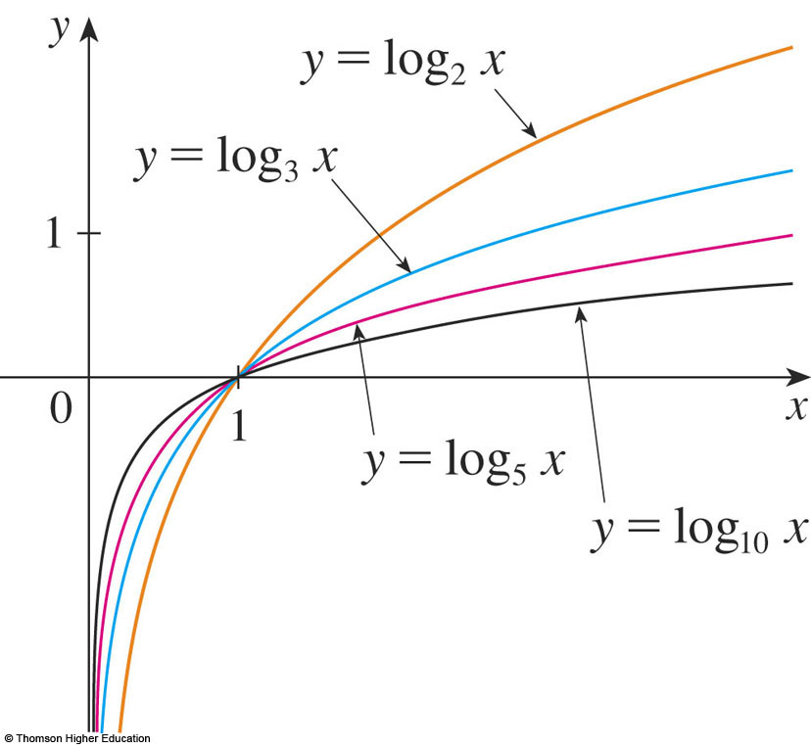
LOGARITHMIC FUNCTIONS
The logarithmic functions ,
where the base a is a positive constant, are the inverse functions of the exponential functions.
The figure shows the graphs of four logarithmic functions with various bases.
Notes:
0<a≠1; x>0

Slide 31
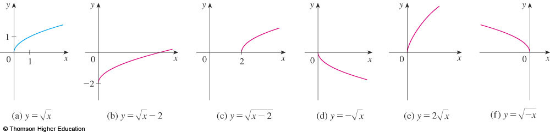
TRANSFORMATIONS
Label the following graph from the graph of
the function y=f(x) shown in the part (a)
y=f(x)-2, y=f(x-2), y=-f(x), y=f(-x)?

Slide 32
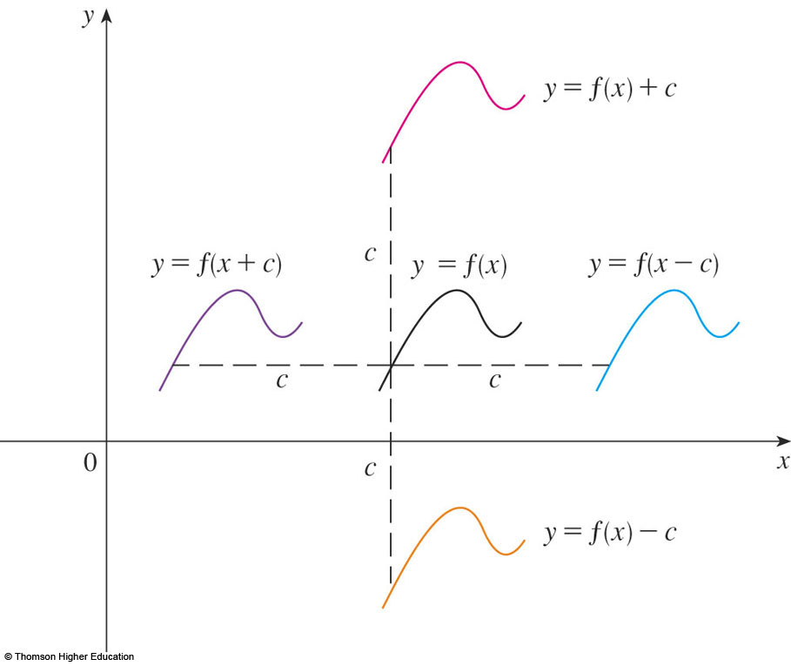
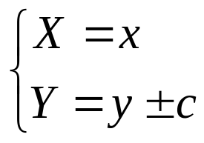
SHIFTING
Suppose c > 0.
  To obtain the graph of
  y = f(x) + c, shift the
  graph of y = f(x)
  a distance c units upward.
  To obtain the graph
  of y = f(x) - c, shift
  the graph of y = f(x)
  a distance c units
  downward.
Why don’t we consider the case c<0?
Notes:
f+c; f-c

Slide 33
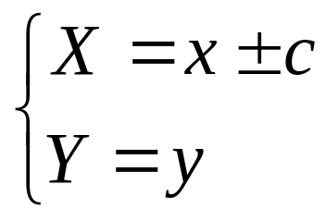
SHIFTING
  To obtain the graph of y = f(x - c), shift the graph of y = f(x) a distance c units to the right.
  To obtain the graph
  of y = f(x + c), shift
  the graph of y = f(x)
  a distance c units to
  the left.
Notes:
x+c; x-c

Slide 34
O

Slide 35
NEW FUNCTIONS FROM OLD FUNCTIONS
Label the following graph from the graph of
the function y=f(x) shown in the part (a)
y=f(x)-2, y=f(x-2), y=-f(x), y=f(-x)?

Slide 36
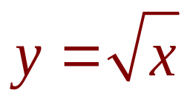
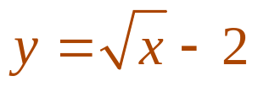
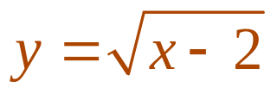
NEW FUNCTIONS FROM OLD FUNCTIONS
Label the following graph from the graph of
the function shown in the part (a):
y=f(x)-2, y=f(x-2), y=-f(x), y=f(-x)?
by shifting 2 units downward.
by shifting 2 units to the right.

Slide 37
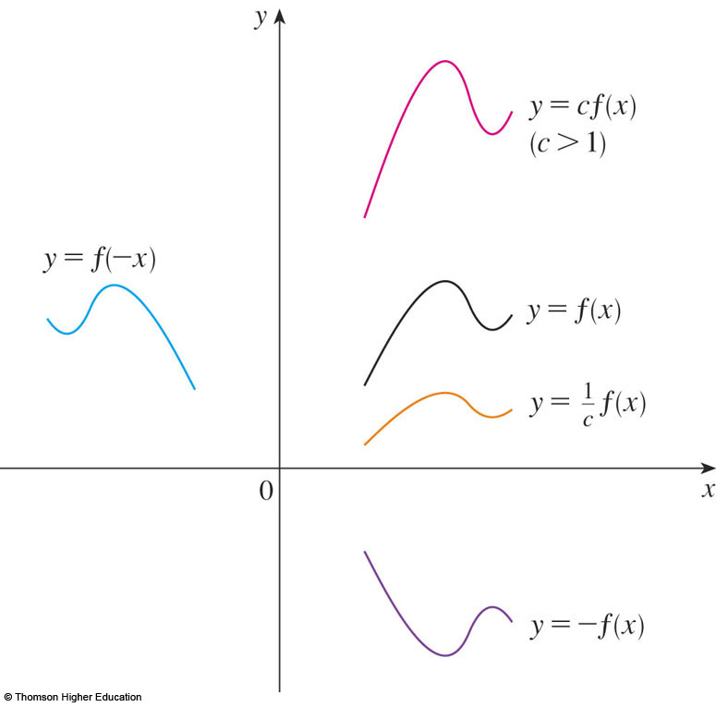
TRANSFORMATIONS
Suppose c > 1.
  To obtain the graph
  of y = cf(x), stretch
  the graph of y = f(x)
  vertically by a factor
  of c.
  To obtain the graph
  of y = (1/c)f(x),
  compress the graph
  of y = f(x) vertically by
  a factor of c.
How about the case c<1?
Notes:
f.c; f/c

Slide 38
TRANSFORMATIONS
  In order to obtain the graph of y = f(cx),
  compress the graph of y = f(x) horizontally
  by a factor of c.
  To obtain the graph
  of y = f(x/c), stretch
  the graph of y = f(x)
  horizontally by a factor
  of c.
Notes:
x.c; x/c

Slide 39
TRANSFORMATIONS
  In order to obtain the graph of y = -f(x),
  reflect the graph of y = f(x) about the x-axis.
  To obtain the graph
  of y = f(-x), reflect
  the graph of y = f(x)
  about the y-axis.
Notes:
y and –y symmetrically by Ox
x and –x symmetrically by Oy

Slide 40
NEW FUNCTIONS FROM OLD FUNCTIONS
Label the following graph from the graph of
the function shown in the part (a):
y=f(x)-2, y=f(x-2), y=-f(x), y=2f(x), y=f(-x)?

Slide 41
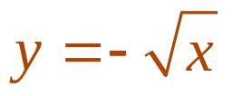
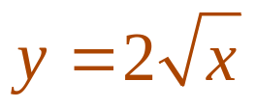
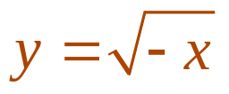
NEW FUNCTIONS FROM OLD FUNCTIONS
Label the following graph from the graph of
the function shown in the part (a):
y=f(x)-2, y=f(x-2), y=-f(x), y=2f(x), y=f(-x)?
  by reflecting about the x-axis.
  by stretching vertically by a factor of 2.
  by reflecting about the y-axis

Slide 42
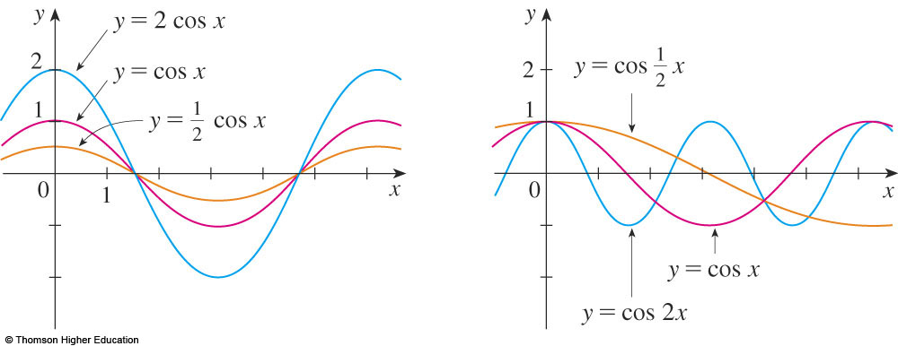
TRANSFORMATIONS
The figure illustrates these stretching
transformations when applied to the cosine
function with c = 2.

Slide 43
Example
Suppose that the graph of f is given.
Describe how the graph of the function f(x-2)+2
can be obtained from the graph of f.
Select the correct answer.
a. Shift the graph 2 units to the left and 2 units down.
b. Shift the graph 2 units to the right and 2 units down.
c. Shift the graph 2 units to the right and 2 units up.
d. Shift the graph 2 units to the left and 2 units up.
e. none of these
Answer: c

Slide 44
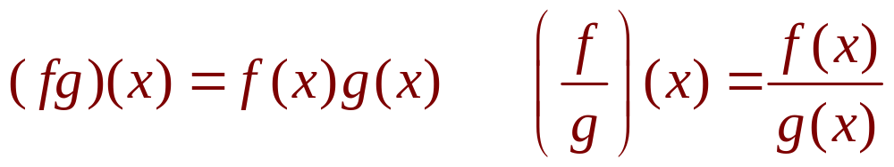
COMBINATIONS OF FUNCTIONS
Two functions f and g can be combined to form new functions:
  (f + g)x = f(x) + g(x)
  (f – g)x = f(x) – g(x)
Notes:
Domain of new function

Slide 45
Let h(x)=f(g(x)).
If g(x)=x-1 and h(x)=3x+2 then f(x) is:
3x+3 b. 3x+4 c. 3x+1 d. None of them
2) If h(x)=3x+2 and f(x)=x-1 then g(x) is:
a. 3x+3 b. 3x+4 c.3x+1 d. None of them
Answer: 1) d 2) a

Slide 46
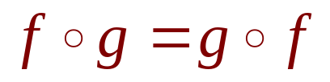


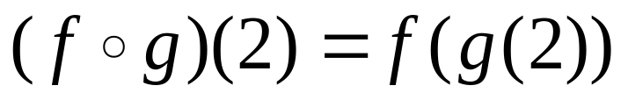
1.2 QUIZ QUESTIONS
If f and g are functions, then
True b. False
2)
is
a. 5 b. 1 c. 2 d. None of the others
x | 1 | 2 | 3 | 4 | 5 | 6
 | 3 | 2 | 1 | 0 | 1 | 2
 | 6 | 5 | 2 | 3 | 4 | 6
.

Slide 47

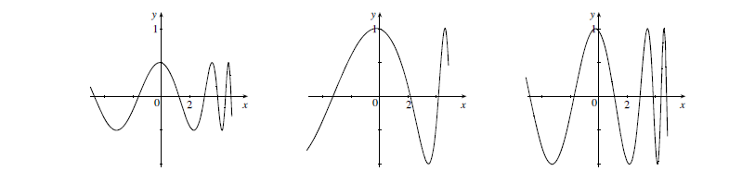
1.2 QUIZ QUESTIONS
Answer: ½ f(x), f(½ x), f(x)

Slide 48
LIMITS
1.3
The Limit of a Function
In this section, we will learn:
About limits in general and about numerical
and graphical methods for computing them.
Notes:
The various meanings of “limit” (descriptive, numeric, graphic), both finite and infinite.
The geometric and limit definitions of vertical asymptotes.
The advantage and disadvantage of using a graphing device to compute a limit.

Slide 49
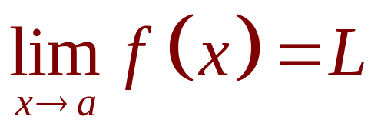
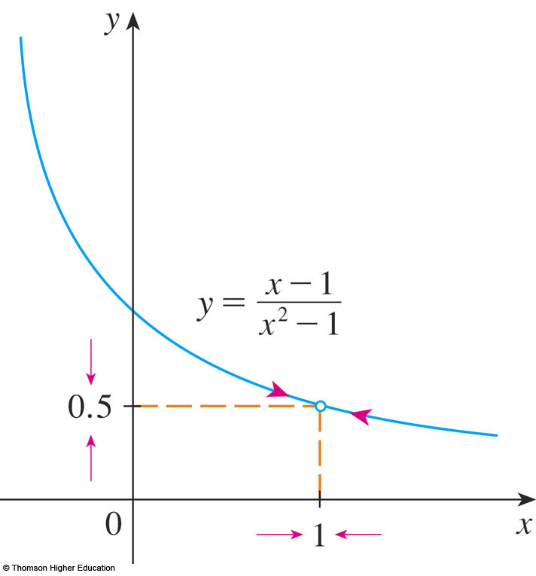
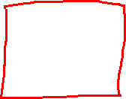

THE LIMIT OF A FUNCTION
In general, we write
if we can make the values
of f(x) arbitrarily close to L
by taking x to be
sufficiently close to a
but not equal to a.
Notes:
f close to L by taking x to be sufficiently close to a but not equal to a

Slide 50


1
0

Slide 51


ONE-SIDED LIMITS
Definition 2
We write
if we can make the values of f(x) arbitrarily close to L by
taking x to be sufficiently close to a and x greater than a.

Slide 52

ONE-SIDED LIMITS
Definition 2
We write
if we can make the values of f(x) arbitrarily close to L by
taking x to be sufficiently close to a and x less than a.

Slide 53








ONE-SIDED LIMITS
Similarly, “the right-hand limit of f(x) as x approaches a is equal to L” and we write

Slide 54



Slide 55
LIMITS
1.4
Calculating Limits
Using the Limit Laws
In this section, we will:
Use the Limit Laws to calculate limits.
Notes:
The algebra computation of limits: manipulating algebraically, examining left- and right –hand limits, using the limit laws to break monstrous functions into pieces and analyzing the pieces.
The evaluation of limit from graphical representation.
Examples where limits don’t exist.

Slide 56







THE LIMIT LAWS
Suppose that c is a constant and the limits
and exist. Then

Slide 57






USING THE LIMIT LAWS
where n is a positive integer.

Slide 58




Slide 59


Slide 60


Slide 61


Slide 62

DIRECT SUBSTITUTION PROPERTY
We state this fact as follows. If f is a polynomial or a rational function and a is in the domain of f, then

Slide 63


USING THE LIMIT LAWS
Theorem 1
if and only if

Slide 64


USING THE LIMIT LAWS
Example 8
Prove that does not exist.
Notes:
Use Vertical Test?

Slide 65


PROPERTIES OF LIMITS
Theorem 2
If when x is near a (except possibly at a) and the limits of f and g both exist as x approaches a, then
Notes:
the limits both exist

Slide 66




SQUEEZE THEOREM
Theorem 3
The Squeeze Theorem (the Sandwich Theorem or the Pinching Theorem) states that, if
when x is near a (except possibly at a) and .Then

Slide 67



USING THE LIMIT LAWS
Example 11
Show that
  Note that we cannot use
  This is because does not exist.

Slide 68




USING THE LIMIT LAWS
Example 11
  However, since ,
  we have:
Taking f(x) = -x², and h(x) = x²
in the Squeeze Theorem,
we obtain:

Slide 69


1.4 QUIZ QUESTIONS
If
then
a. True b. False
Notes:
For example …

Slide 70
1.4 QUIZ QUESTIONS
If
a. True b. False
Notes:
For example …

Slide 71
LIMITS
1.5
Continuity
In this section, we will:
See that the mathematical definition of continuity
corresponds closely with the meaning of the word
continuity in everyday language.
Notes:
The graphical and mathematical definitions of continuity and the basic principles.
Examples of discontinuity
The Intermediate Value Theorem.

Slide 72




CONTINUITY
1. Definition
A function f is continuous at a number a if:
Notice that :
  f(a) is defined - that is,
  a is in the domain of f
  exists.
Notes:
When function f is NOT continuous at a number a?

Slide 73

CONTINUITY
Definition
If f is defined near a - that is, f is defined on an open interval containing a, except perhaps at a - we say that f is discontinuous at a if f is not continuous at a.
The figure shows the graph of a function f.
At which numbers is f discontinuous?
Why?

Slide 74


Slide 75


CONTINUITY
2. Definition
A function f is continuous from the right
at a number a if
and f is continuous from the left at a if

Slide 76


Slide 77
CONTINUITY
3. Definition
A function f is continuous on an interval if it is continuous at every number in the interval.
  If f is defined only on one side of an endpoint of the interval, we understand ‘continuous at the endpoint’ to mean ‘continuous from the right’ or ‘continuous from the left.’

Slide 78

CONTINUITY
4. Theorem
If f and g are continuous at a; and c is a constant, then the following functions are also continuous at a:
1. f + g
2. f - g
3. cf
4. fg
5.

Slide 79
CONTINUITY
7. Theorem
The following types of functions are continuous at every number in their domains:
  Polynomials
  Rational functions
  Root functions
  Trigonometric functions
  Power functions
  Exponential functions
  Logarithmic functions
Notes:
List domain of these functions

Slide 80




f(x) xác định
TXĐ
f(x) liên tục tại

Slide 81



CONTINUITY
8. Theorem
If f is continuous at b and then
In other words,
  If x is close to a, then g(x) is close to b; and, since f
  is continuous at b, if g(x) is close to b, then f(g(x))
  is close to f(b).
Notes:
For example

Slide 82

CONTINUITY
9. Theorem
If g is continuous at a and f is continuous at g(a), then the composite function
is continuous at a.
  This theorem is often expressed informally by saying
  “a continuous function of a continuous function is
  a continuous function.”
Notes:
For example

Slide 83



INTERMEDIATE VALUE THEOREM
10. Theorem
Suppose that f is continuous on the closed interval
[a, b] and let N be any number between f(a) and f(b), where
Then, there exists a number c in (a, b) such that f(c) = N.

Slide 84


Slide 85




INTERMEDIATE VALUE THEOREM
Example 9
Show that there is a root of the equation
between 1 and 2.
  Let .
  We are looking for a solution of the given equation—
  that is, a number c between 1 and 2 such that f(c) = 0.
  Therefore, we take a = 1, b = 2, and N = 0 in the theorem.
  We have
  and
Notes:
Exists a root of the equation, can not solve

Slide 86





1.5 QUIZ QUESTIONS
1) If f(1)>0 and f(3)<0 then there exists a number c between 1 and 3
such that f(c)=0
True b. False
2) Which is the equation expressing the fact that “ f is continuous at 2”?
a. b.
c. d.
e.

Slide 87
1.6
Limits involving infinity
We will study:
Infinity Limits
Limits at Infinity
Notes:
Lim y = ∞; x → ∞

Slide 88


INFINITE LIMITS
Definition 4
Let f be a function defined on both sides of a, except
possibly at a itself. Then,
means that the values of f(x)
can be made arbitrarily large
by taking x sufficiently
close to a, but not equal to a.
Notes:
For example

Slide 89


INFINITE LIMITS
Definition 5
Let f be defined on both sides of a, except possibly at a
itself. Then,
means that the values of f(x)
can be made arbitrarily
large negative by taking x
sufficiently close to a,
but not equal to a.
Notes:
For example

Slide 90





INFINITE LIMITS
Similar definitions can be given for the one-sided limits:

Slide 91
DEFINITIONS
x=a is called the vertical asymptote of f(x) if we have one of the following:
Notes:
For example

Slide 92



LIMITS AT INFINITY
Let f be a function defined for every x>a. Then
means that

Slide 93

L
f(x)

Slide 94

L
f(x)

Slide 95

DEFINITION
The line y = L is called the horizontal asymptote of f(x) if we have one of the following:
Notes:
For example

Slide 96



Find the asymptotes of the function
Solution
y=1 is horizontal asymptote

Slide 97


Slide 98

Compute
a.
b.
c.
d.
0
0
Does not exist
Notes:
Using limit laws

Slide 99


1.6 QUIZ QUESTIONS
1) Find
a. 0 b. infinity c. 1 d. Does not exist
2) Find
a. 0 b. infinity c. 1 d. Dose not exist

Slide 100


1.6 QUIZ QUESTIONS
3) If
Then
a. True b. False
4) A function can have two different horizontal asymptotes
a. True b. False
Notes:
For example…

Slide 101
Exercises
Section I.1 20,35,43,49 (p 9,10)
Section I.2 : 49,52,54,61 (p 23,24)
I.4: 18, 29 (p44,45)
I.6: 22,24,26 (p67)
47 page 72

Slide 102
Thanks

